Slide 1
Chicago Crime Forecasting

Slide 2
Content
Introduction
Dataset description
Methodology
Modelling and results
Conclusion

Slide 3

Introduction
One of our society's most significant and pervasive issues is a crime. Numerous crimes are perpetrated often each day. In this project, the criminal activities reported are based on several circumstances such as theft, murder, assault, homicide, burglary, etc.
These crimes happen in small villages, towns to big cities. In order to curtail this issue we require the power to predict the trends of crimes.
You guys are too early!

Slide 4
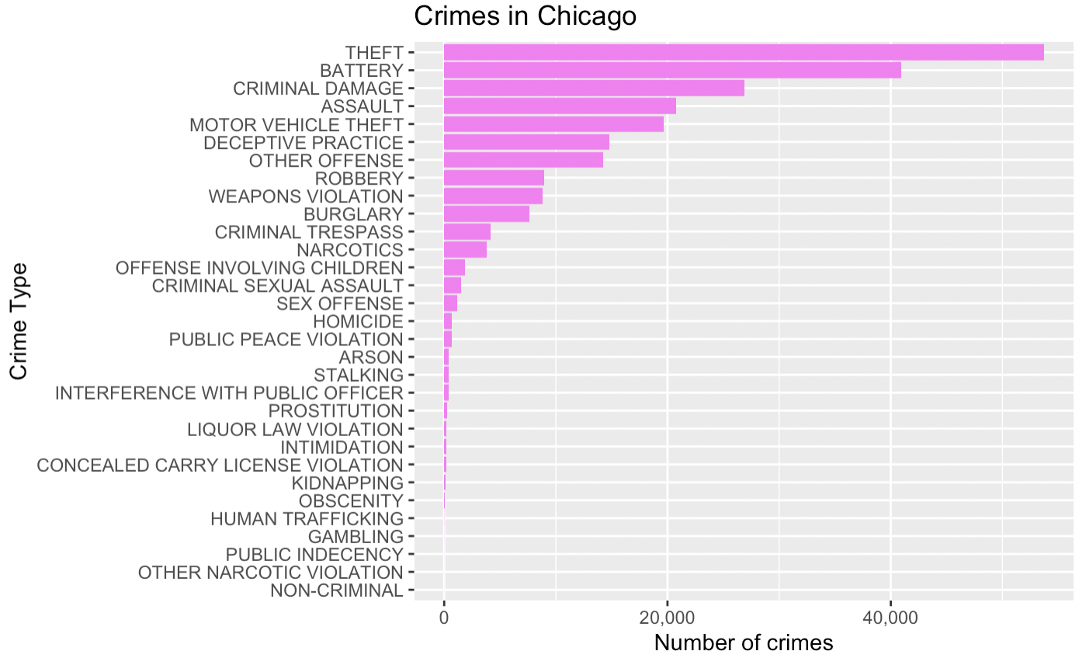
Dataset description
This dataset contains the reported criminal activity that took place in Chicago in the year 2020. It is classified under the category of Public Safety. The CLEAR system of the Chicago Police Department is used to extract data.
The dataset is a Time Series specific through which we can forecast.
The dataset contains 17 features and up to 200,000 records.
Among these features we are concerned about thefts that have happened.
Why Theft ?
We are highlighting theft class because we notice that theft activities have more frequency among the others from the bar plot.
So we are going to use this to forecast theft in Chicago city.
4

Slide 5

Methodology
Seasonal Naive
Time Series Forecasting helps us to analyze and forecast or compute the probability of an incident, based on data stored with respect to changing time.
In a nut shell, time series forecasting involves forecasting and extrapolating future trends or values based on old data points, clustering them into groups, and predicting future patterns.
We consider the events of theft w.r.t to date as the measure that repeats at a specific frequency.
We are going to use Mean, Naïve, Seasonal Naïve, Drift and ARIMA models to forecast the trend of theft.
Naive
Drift
MEAN
ARIMA

Slide 6
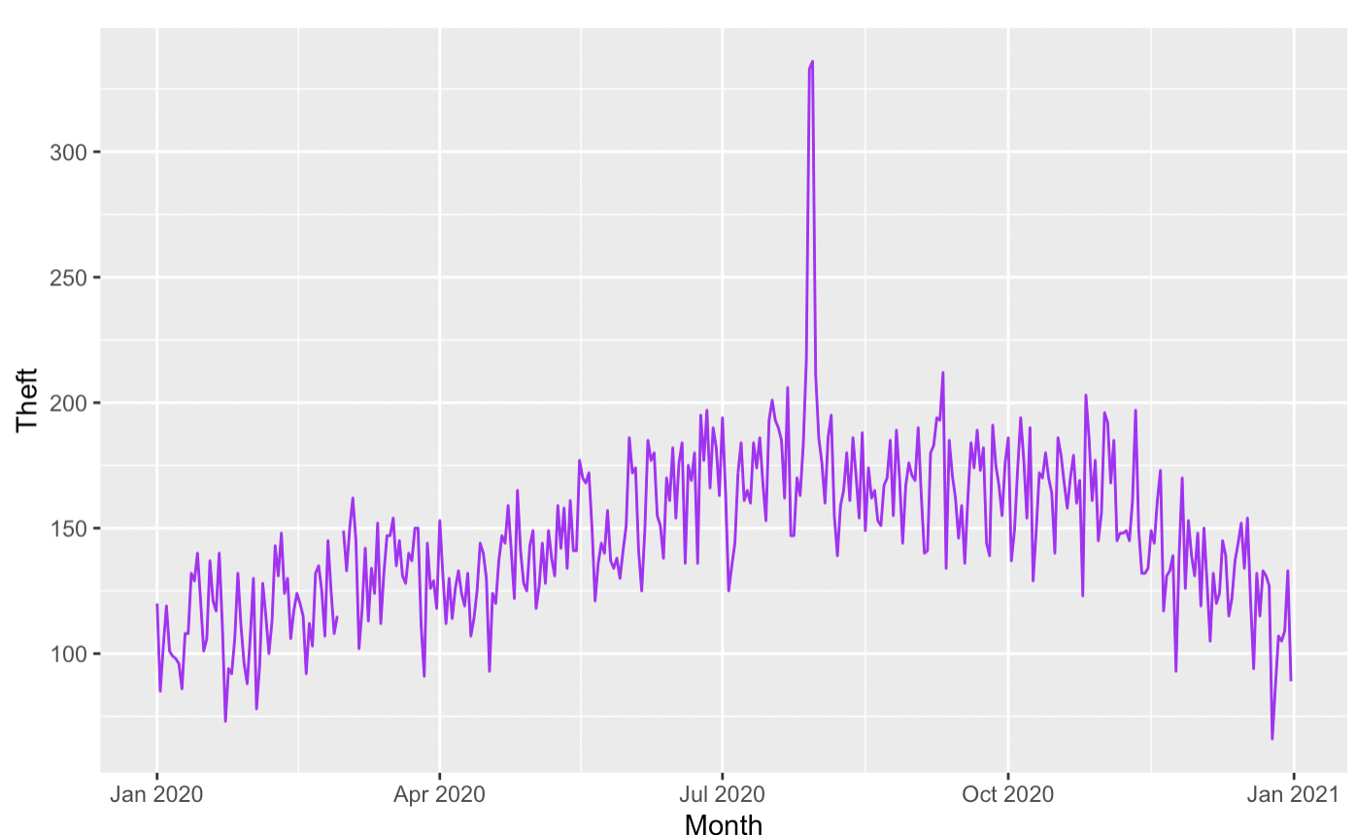
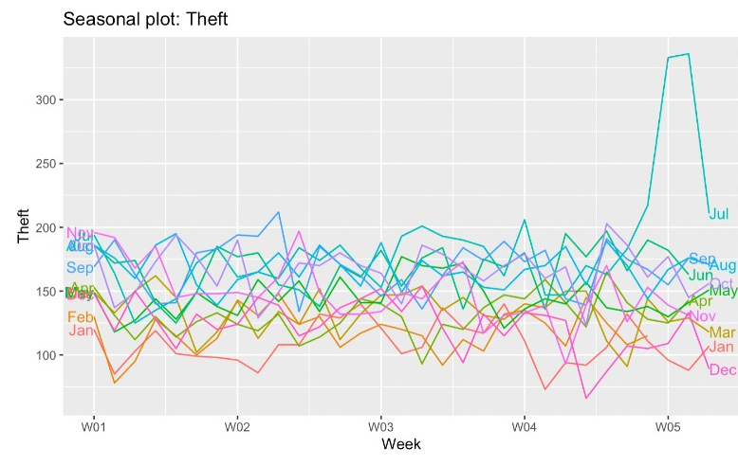
Theft variation
Theft variation over an year
Theft seasonal variation

Slide 7
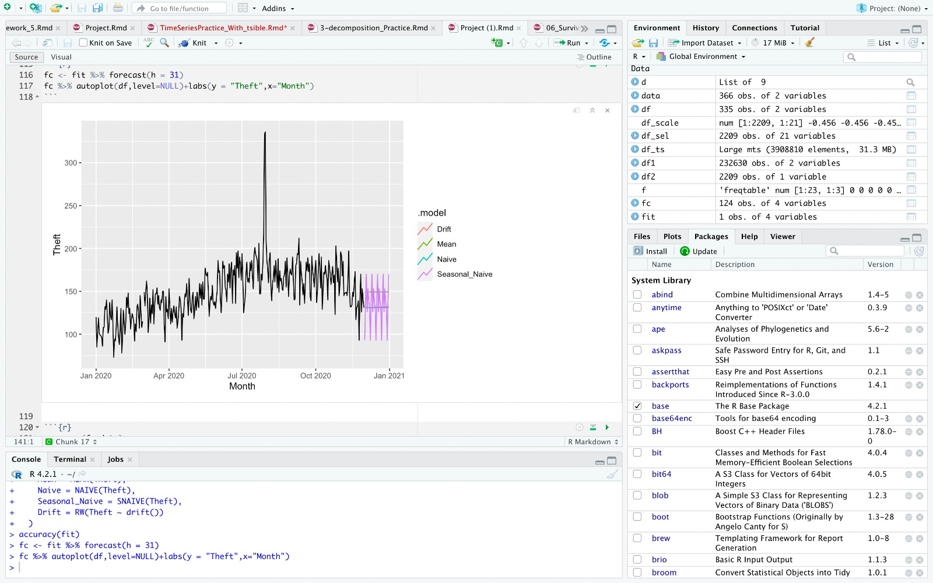
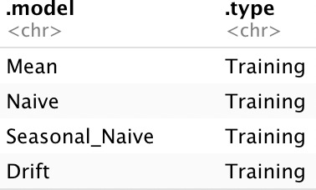
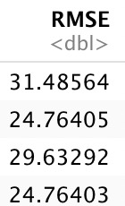
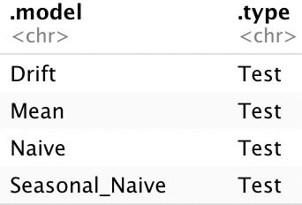
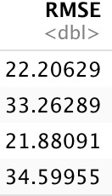
Using Mean, Naive, Seasonal Naive and Drift model
In mean method the forecasts of all future values are equal to the average of the historical data.
The naive approach considers what happened in the previous period and predicts the same thing will happen again.
Seasonal naive approach is beneficial for highly seasonal data. In this scenario, we set each forecast to be equal to the last observed value from the same season.
Model drift represents a change in a model's predictions over time. Prediction drift also represents a shift in predictions from new values compared to pre-produced predictions.
Results

Slide 8
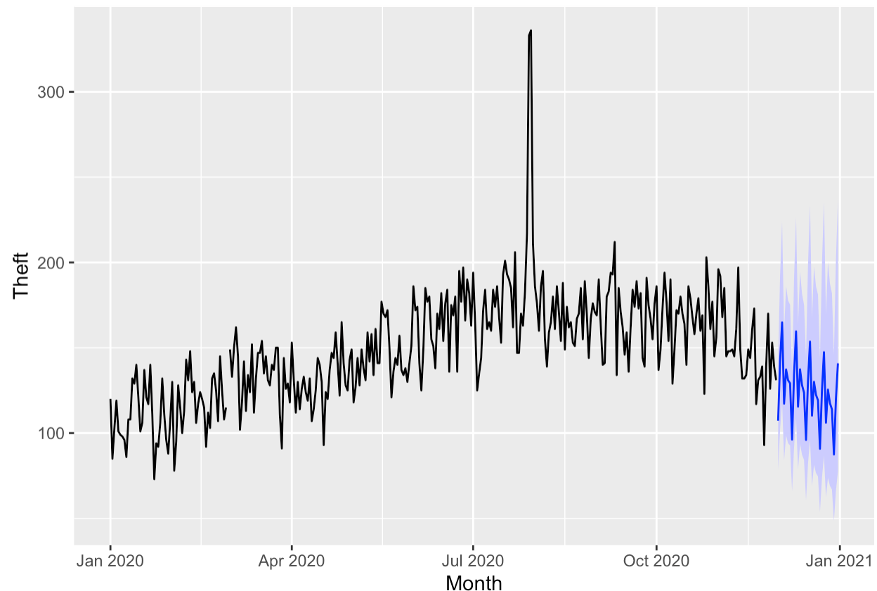
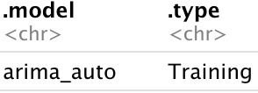

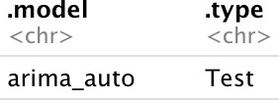

Arima Model
ARIMA makes use of lagged moving averages to smooth time series data.
They are frequently utilized in technical analysis to predict upcoming asset price trends.
Autoregressive models implicitly presume that the future will mimic the past.
p=order of the autoregressive part (1) d= degree of first differencing involved (1) q=order of the moving average part (0)
Results
ARIMA model now forecasts theft activity from Dec to Jan 2021

Slide 9
Conclusion
The plots forecasts that the theft activity trend is decreasing.
From the results we infer that ARIMA model gives us the best result considering the RMSE value because RMSE is the one that makes predictions that are closest to the actual values from the dataset.

Slide 10
References
Dataset source: https://data.cityofchicago.org/api/views
https://otexts.com/fpp3

